Slide 1
Multi-Player Reach-Avoid Games
Zhengyuan Zhou, Mo Chen and Claire Tomlin

Slide 2
Mo’s Law
A presentation always takes longer than you think, even if you take Mo’s Law into account.

Slide 3
Outline
Motivations (general and specific)
Problem Formulation
Path Defending
Quantifying Conservatism
Two-Player Reach-Avoid Games:
The General Case
Simply connected domains
Convex Domains
Simulations
Multi-Player Reach-Avoid Games
Conclusion and Future Work

Slide 4
General Motivation
Differential games: characterized by HJI
A Grand Vision: A framework to “approximately solve” a differential game without solving the full HJI
Provide a general framework that is:
Robust to formulations
Not really conservative (and conservatism quantifiable)
Compatible with other frameworks
Computationally Efficient and Scalable
(Provide extra insights that HJI does not provide)

Slide 5
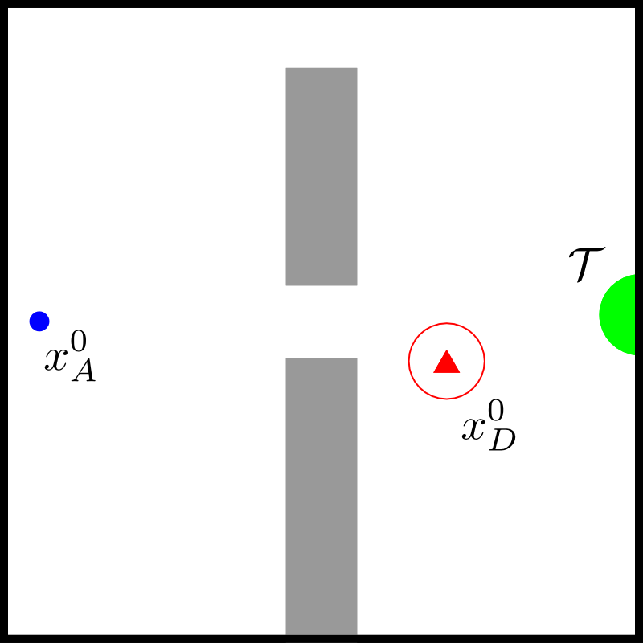
Specific Motivation
We are all bored with Open-Loop

Slide 6
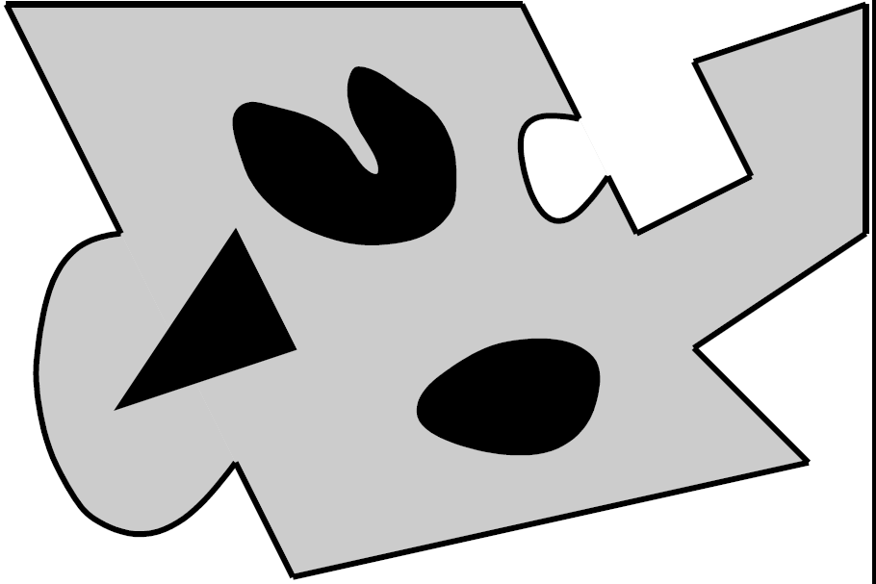
Problem Formulation
A1
A3
D3
A2
T
D1
D2

Slide 7
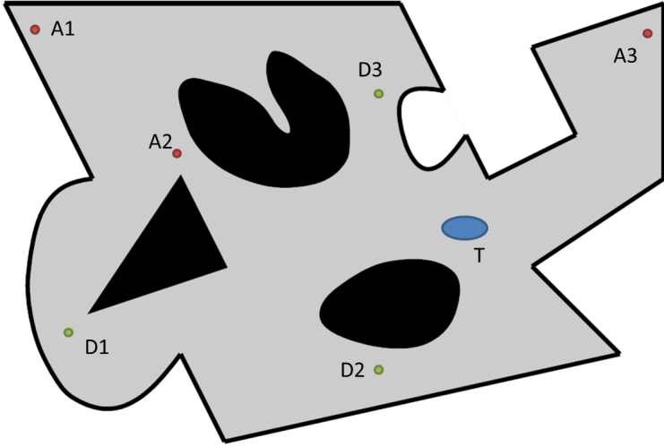
How does the general vision apply?
a general framework:
Robust to formulations
Not really conservative (and conservatism quantifiable)
Compatible with open-loop
Computationally Efficient and Scalable
(Provide extra insights that HJI does not provide)

Slide 8
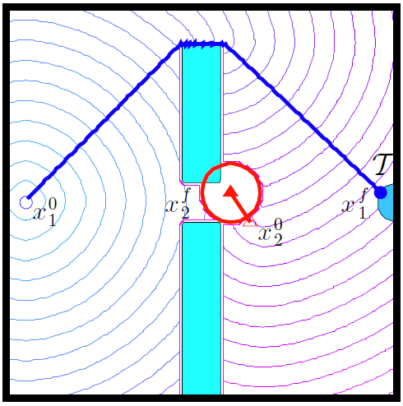

Path Defense
Observation:
Inspiration: path defense from Pursuit-Evasion

Slide 9
Guarding a Path
A path is guardable if after a finite amount of time, the defender can ensure that the attacker will not cross the path ever again
Note the “after a finite amount of time”!

Slide 10
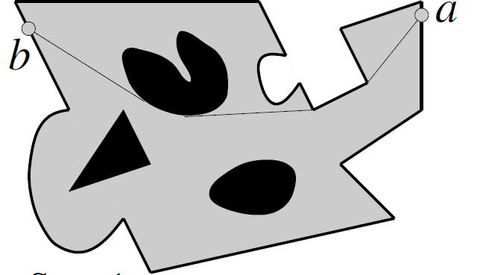
How to Guard a Path
A
D
D chooses b as an anchor point and goes to b
After D reaches b, D finds the projection image A’ of A on path ba (i.e. d(b,A’) = d(b, A))
D goes after A’

Slide 11
But Guarding is not Enough
A path is defendable if the defender has a feedback strategy to ensure that the attacker does not the path
Solving a path defense problem is as hard as solving a reach-avoid game
Path defendable iff
Region defendable
Region defendable
Path defendable
Optimal Way to Defend a Path: HJI

Slide 12
But No, No HJI
A path is strongly defendable if the defender has a feedback strategy to ensure the attacker does not cross the path subject to:
the defender will be on the path after finite time (and may leave thereafter)
Intuitively, the constraint is reasonable and unrestrictive
Unclear why this is simpler. (Still need to solve an HJI for optimally strongly defending a path?)

Slide 13
Let’s consider shortest paths
An example for defending a shortest path:
e1
e1D is automatically strongly defended
See board for this rotation strategy
A
D
D’
e2
Hence, e1D’ is also strongly defendable

Slide 14
It looks complicated
D moves to e1D’ in a closed-loop way(i.e. depending on what A is doing)
D moves in a quite complicated way to D’
Side note: it raises an interesting question of how far D can rotate (will get to if time)

Slide 15
The Optimal Strategy is Factorizable
Into:
An open-loop control in the first stage
A (not necessarily unique) simple closed-loop strategy in the second stage
If the closed-loop strategy in the second stage is unique, then we know it’s on the boundary of some winning (or losing) configuration

Slide 16
Defending a shortest path
Terminal Condition: if D just reaches the path
We could solve a 3D HJI, but no need!
Region I
D starts here
e1
A starts here
e2
Region II

Slide 17
A can cross iff A is either in Region I or Region II
If A is here, just go to e1
Region I
D just reached this point
e1
If A is here, it can’t cross
If A is here, just go to e2
See Board for justifications and beyond
e2
Region II

Slide 18
But D doesn’t start on the line
D needs to go to a point on the line, that takes time!
If D makes up his mind to go to a point p, he’d better reach that point before A reaches either Region I or Region II associated with p
So, test point by point. Naïve, but still it’s 1D
We will work very hard to be lazy

Slide 19
A Surprising Message
Only one point needs to be checked
The point p on the shortest path such that:
d(p, Region I) = d(p, Region II)
Such a p uniquely exists, can be found quickly (via FMM) and if p doesn’t work, no other point works (see board).

Slide 20
Why is it surprising?
While D is moving towards the shortest path, D may want to take into account A’s actions(we’ve seen examples before)
But our strategy can be factored into 2 stages, the first stage is open-loop(resulting in straight lines)
Our strategy is optimal for strongly defending a shortest path.(i.e. if it doesn’t work, no other strategy works)
Our strategy may not be optimal for defending a path. (i.e. if it doesn’t work, others may still work)

Slide 21
Other Observations
Once p reaches a shortest path, there’s no point for it to do anything else other than patrolling the path
Hence, if a shortest path is strongly defendable, then any path past it (with respect to A) is strongly defendable

Slide 22
Quantifying Conservatism
A path that is defendable but not strongly defendable (see board)
So indeed, this is (a little bit) conservative
How do we quantify conservatism? What’s a good metric?

Slide 23
General Paradigm: Upper and Lower Bounds
An ideal way to quantify conservatism:
Compare how well our framework can do with how well the best framework can do
But:
It’s computationally expensive to know how well our framework can do
It’s computationally expensive to know how well our framework can do
Hence, we conservatively quantify our conservatism
Compare how well at least our framework can do with how well at most the best framework can do

Slide 24
Specifically In this Case:
Ideally, we want:
The set of all shortest paths strongly defendable using our method
The set of all paths defendable using HJI
But if too computationally expensive:
The set of all shortest paths strongly defendable using our method
Voronoi cell of the defender(i.e. if not in this set, then it’s guaranteed that a path is not defendable)(for convex cases, it’s exact)

Slide 25
A Concrete Example
A shortest strongly defendable path induces a region
another region induced
Conservative ration = area(union all such regions) / area(voronoi cell of D)

Slide 26
An algorithm for computing the ratio
Voronoi area is easy to compute
A binary search-based method to compute the best strongly defendable path given an anchor point
Choose another anchor point, do a binary search, but only in the remaining area

Slide 27
Two-Player Reach-Avoid Games:
Use path defense to solve two-player reach-avoid games:
The General Case
Simply connected domains
Convex Domains
We are able to say more and more about less and less

Slide 28
The General Case
A General Scheme for Reach-Avoid:
Pick a path, test it, if it doesn’t work, try another one, until you get tired
How to quantify the conservatism?
Given an initial condition of A, find the winning region for D under our framework
Find the winning region for D using HJI
Take the ratio (no simulation for HJI)

Slide 29
Simply Connected Domains
Still pick a path and test it, only need to test path that touches the target (and separates the attacker from the target, of course)
Not true in general domains

Slide 30
Convex Domains
Completely Solved.
Defender wins the game iff its voronoi cell intersects with the target

Slide 31
Movie Time

Slide 32
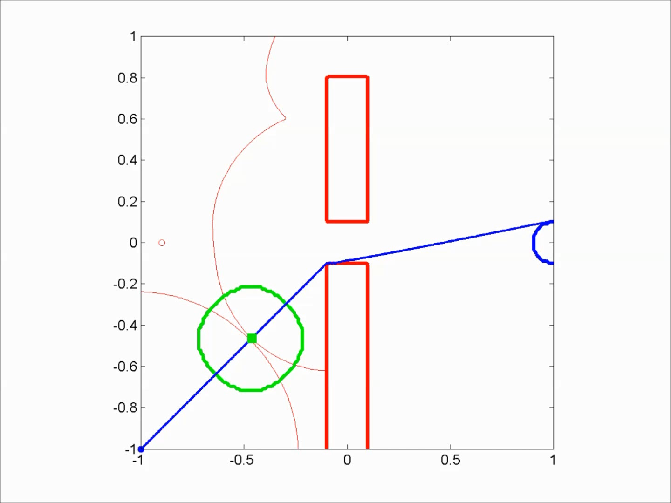
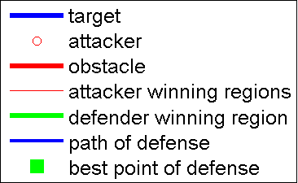
200 by 200 grid

Slide 33
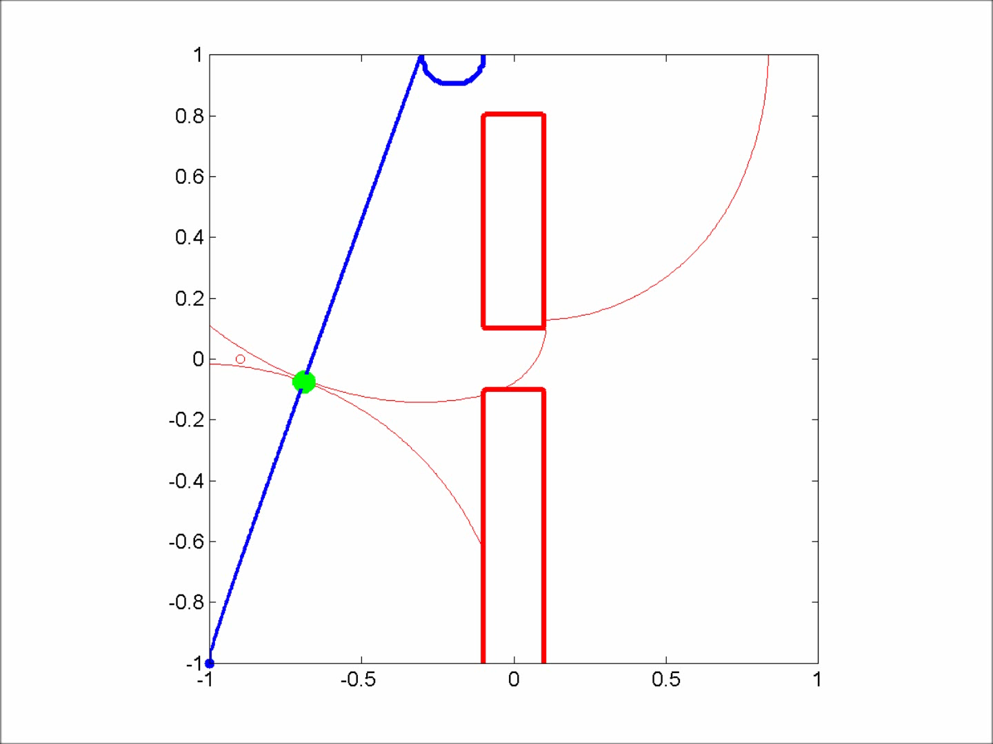
200 by 200 grid

Slide 34
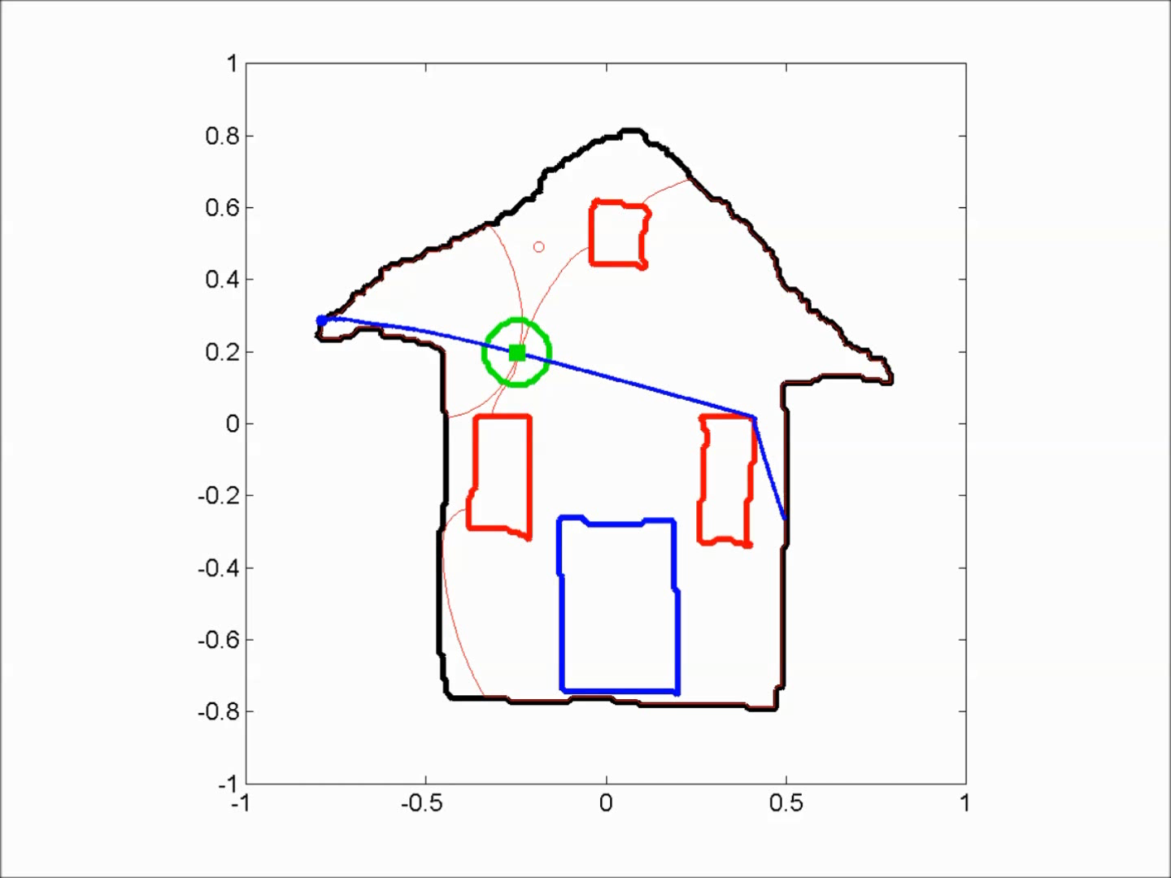
Jeremy’s House
200 by 200 grid

Slide 35
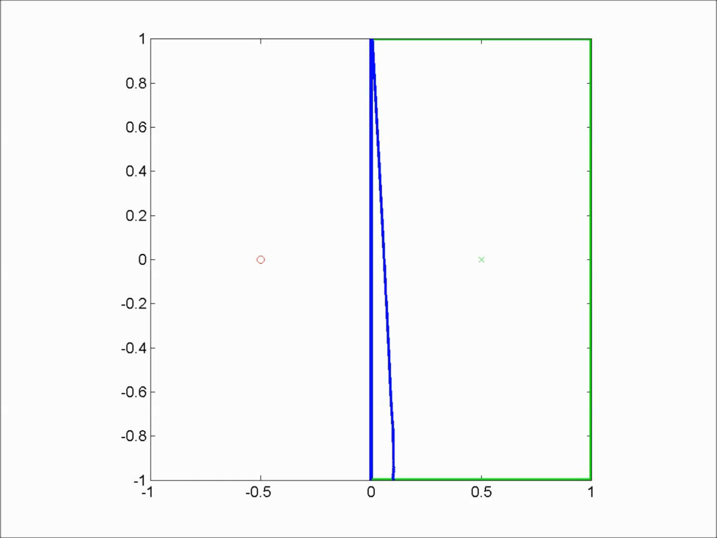
200 by 200 grid
83.4% of voronoi area is defendable

Slide 36
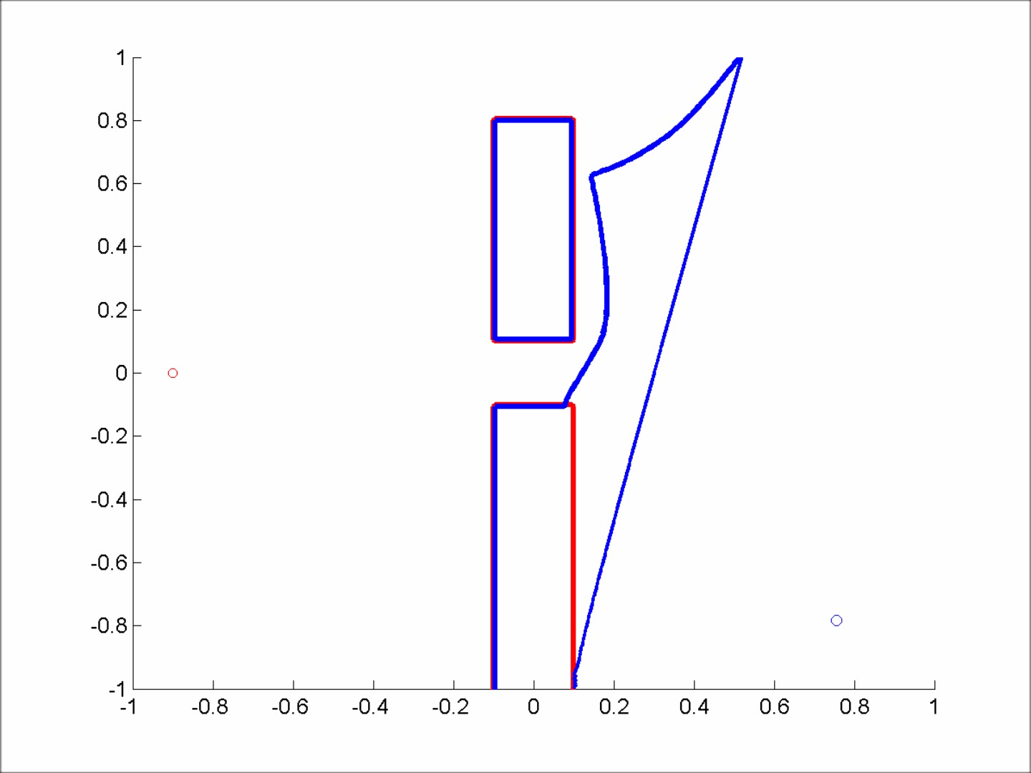
200 by 200 grid
79.3% of voronoi area is defendable

Slide 37
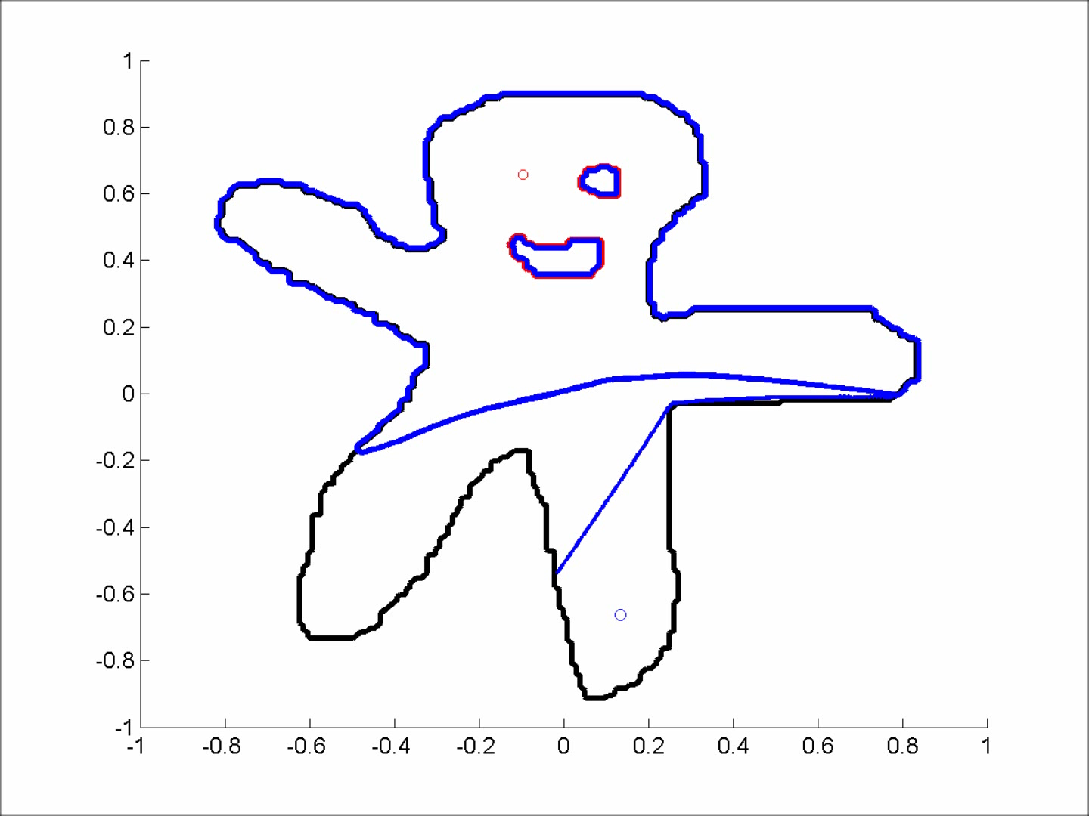
200 by 200 grid
83.2% of voronoi area is defendable

Slide 38
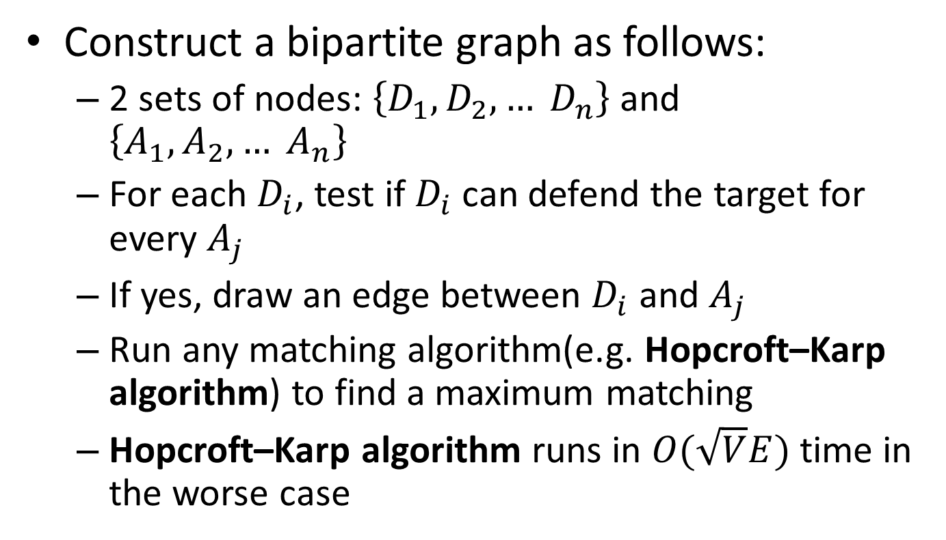
Multi-Player Reach-Avoid Games
Construct a bipartite graph as follows:
2 sets of nodes: $\left\{D_{1}, D_{2}, … D_{n}\right\}$and $\left\{A_{1},A_{2},… A_{n}\right\}$
For each $D_{i}$, test if $D_{i}$ can defend the target for every $A_{j}$
If yes, draw an edge between $D_{i}$ and $A_{j}$
Run any matching algorithm(e.g. Hopcroft–Karp algorithm) to find a maximum matching
Hopcroft–Karp algorithm runs in $O(\sqrt{V}E)$time in the worse case

Slide 39
Conclusion
Grand Vision Achieved here?
Robust to formulations
Not really conservative(and conservatism quantifiable)
Compatible with the open-loop framework
Computationally Efficient and Scalable
Provide extra insights that HJI does not provide

Slide 40
Future Work
Theoretical structure of the strongly defendable regions (connectivity? convexity?...)
Incorporating More Complex Dynamics (Reeds Shepp Car, Dubin’s Car)
More cooperation between defenders(i.e. what if no perfect matching exists?)
Imbalanced team with more attackers than defenders
Suggestions? + Many many more…

